Slide 1
Class 2: Causal vs. Predictive Analytics and Intro to Python
MGSC 310
Ben Labaschin

Slide 2
Class 2: Outline
👈
Causal vs Predictive Analytics
Lab 2: Intro to Python

Slide 3

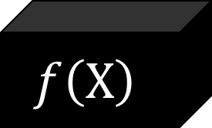
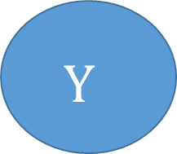
Predictive Analytics
This course will primary cover predictive analytics
Machine learning model
Data
Prediction
This type of analysis assumes the world stays the same
It cannot tell us what would have happened if the world was different

Slide 4


Distinction Between Causal and Predictive Analysis is Subtle!
Causal model asks: If I were to make T (a treatment, such as advertising) happen, what would happen to Y?
Predictive model ask: If I observe X (e.g. individual characteristics), what can I predict about Y (e.g. that person’s likely income?)

Slide 5
Business Intelligence vs. Causal vs. Predictive Analytics
Business intelligence: What happened?
Predictive Analytics: What will happen?
Causal Analysis: What could happen if we do T?

Slide 6
First, An Activity
What is causality? What is prediction? In the following notebook we explore these questions and more!
https://colab.research.google.com/drive/164efDyNsyomX6lsyscSfoaD8XqGIirhK?usp=sharing

Slide 7
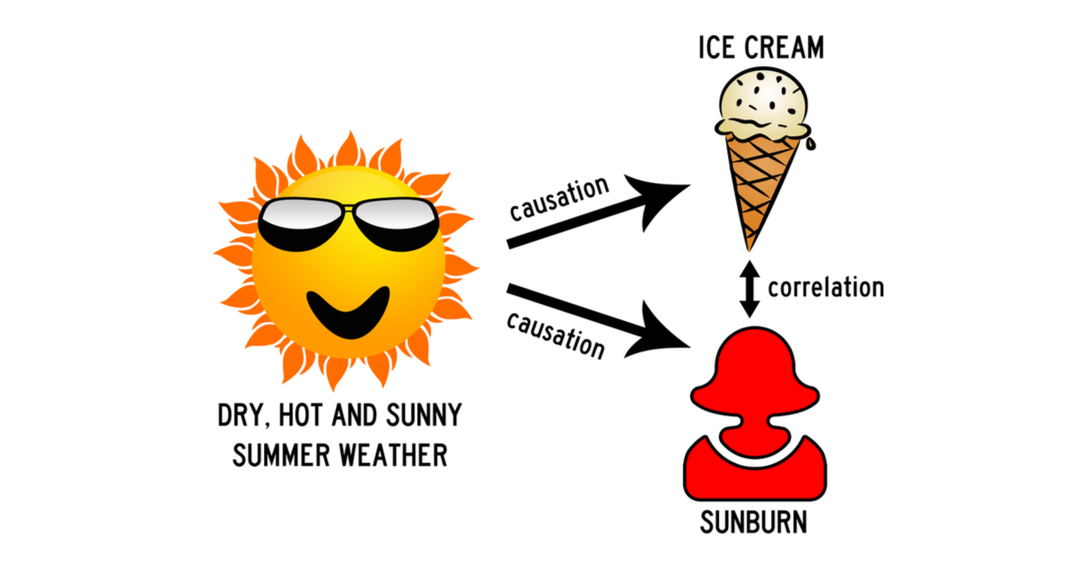
Predictive Analytics vs Causal Inference
Ice cream sales are predictive of sunburns but do not cause sunburns
We all know that correlation =! Causation
Correlation = two series move together!
But sometimes knowing two things are correlated – even if the causal link is unknown -- is useful!

Slide 8
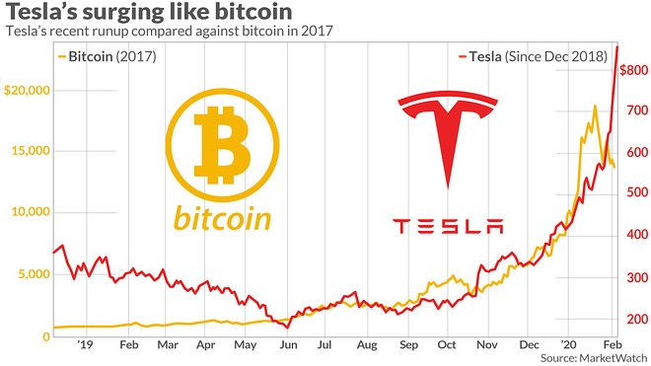
Example of Useful Correlation: Tesla Stock Price Correlated With Bitcoin Price
Is there a causal link?
How can you benefit even if there isn’t a causal link?

Slide 9
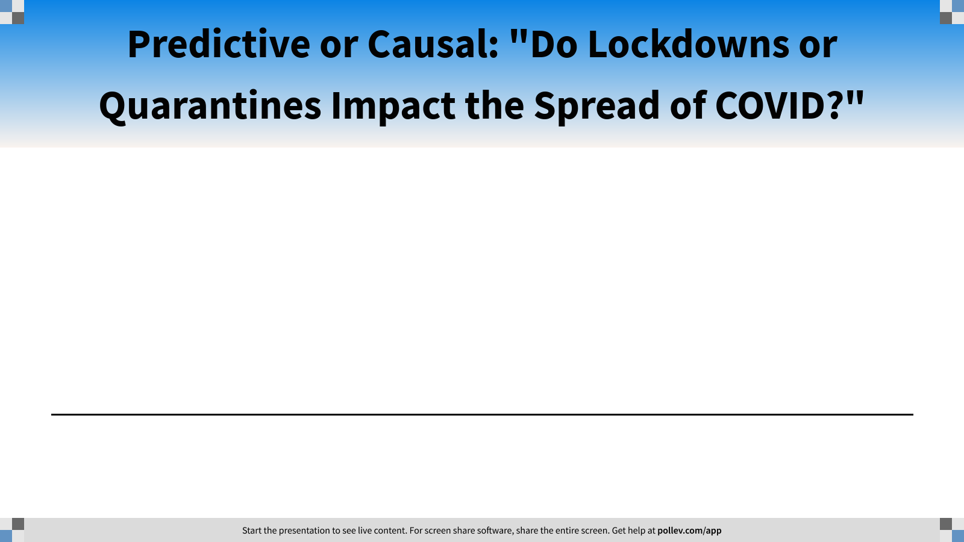
Notes:
Poll Title: Predictive or Causal: "Do Masks Impact the Spread of COVID?" https://www.polleverywhere.com/multiple_choice_polls/v1KcpbZrksvCkru0MFEKm?flow=Default&onscreen=persist

Slide 10
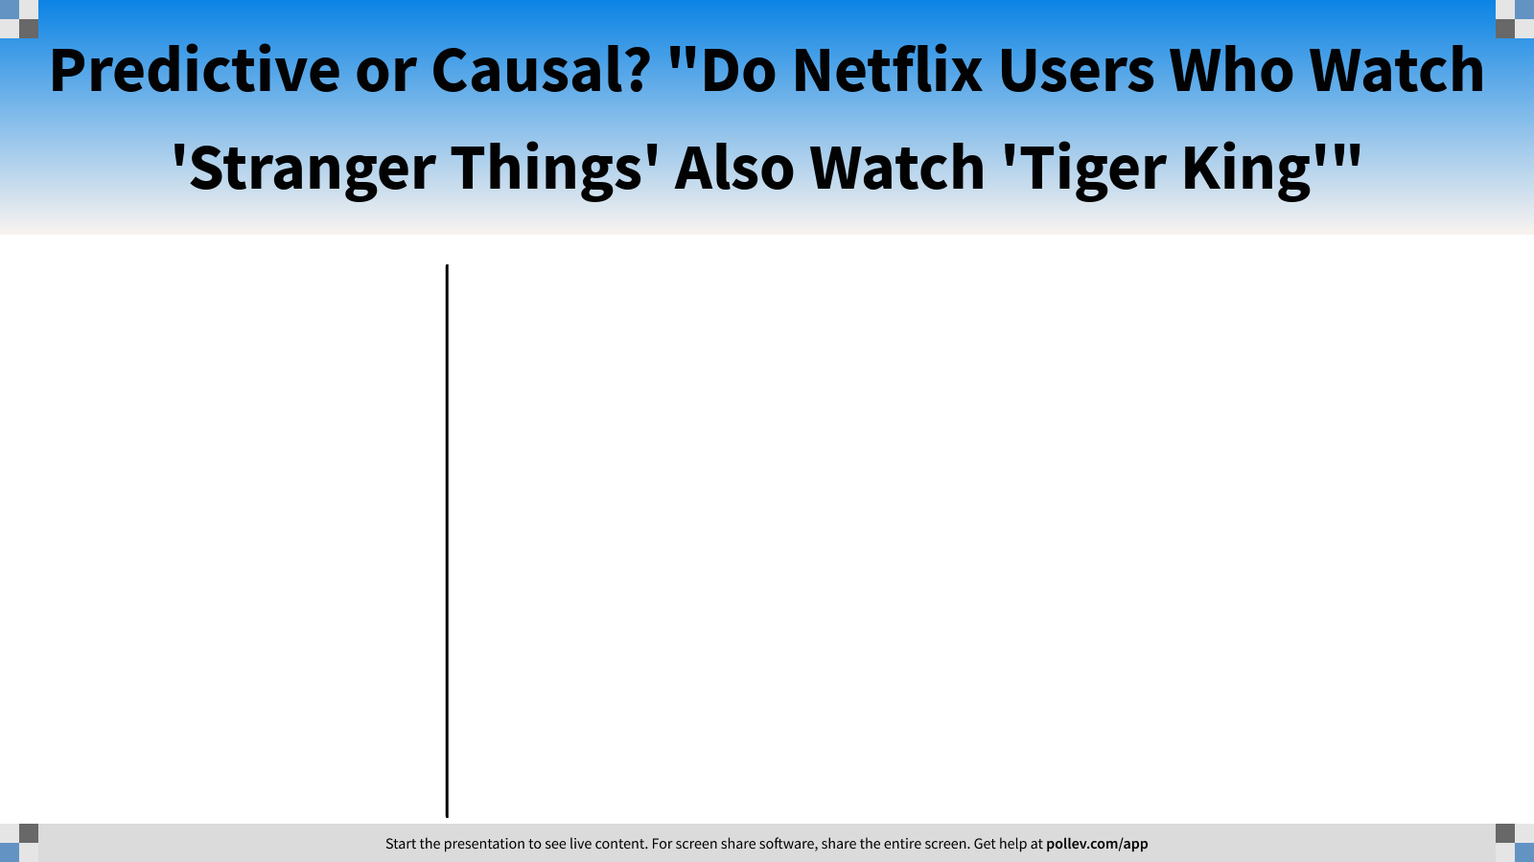
Notes:
Poll Title: Predictive or Causal? "Do Netflix Users Who Watch 'Stranger Things' Also Watch 'Tiger King'" https://www.polleverywhere.com/multiple_choice_polls/5FV5CFIZ7XlUpkTyP6yf2?flow=Default&onscreen=persist

Slide 11

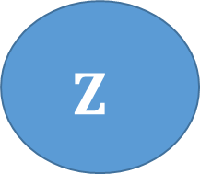
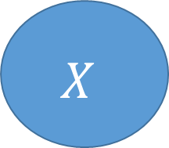
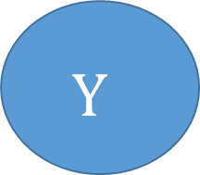
Confounders: Influences Both X and Y
Healthy Lifestyle
You are a doctor and want to understand how carrot juicing (X) impacts heart disease (Y).
You record patient food diaries and find a high prediction between juicing and low heart disease
Why is that not causal?
Something else (patients’ healthy lifestyle) is a confounder to the causal relationship between X and Y
Causation (prediction and causative)
Carrot Juicing
Predictive but not causal
Low Rate of Heart Disease

Slide 12

But Prediction is Very Useful!
Healthy Lifestyle?
Suppose every patient lies about how active they are. (We cannot observe Z)
How is this information useful?
Just knowing whether a patient drinks carrot juice is predictive of whether they have heart disease
I.e. if we know X, we know to whom we should give anti-cholesterol medication
Causation (prediction and causative)
Carrot Juicing
Predictive but not causal
Low Rate of Heart Disease

Slide 13
Summary
Machine learning is a set of statistical methods used by CS people to learn from data.
Predictive analytics: if I know X, what does this tell me about Y? (Cannot estimate a counter-factual)
Causal analysis: if I changed X, how does that cause Y to change? (Can estimate a counterfactual)
A confounder (z) influences both X and Y and results in a spurious correlation (non-causal) between X and Y.
Both predictive and causal analysis are powerful and useful!
Many problems can be solved by either (or both!).

Slide 14
Class 2: Outline
✔️
Causal vs Predictive Analytics
Lab 2: Intro to Python
👈

Slide 15
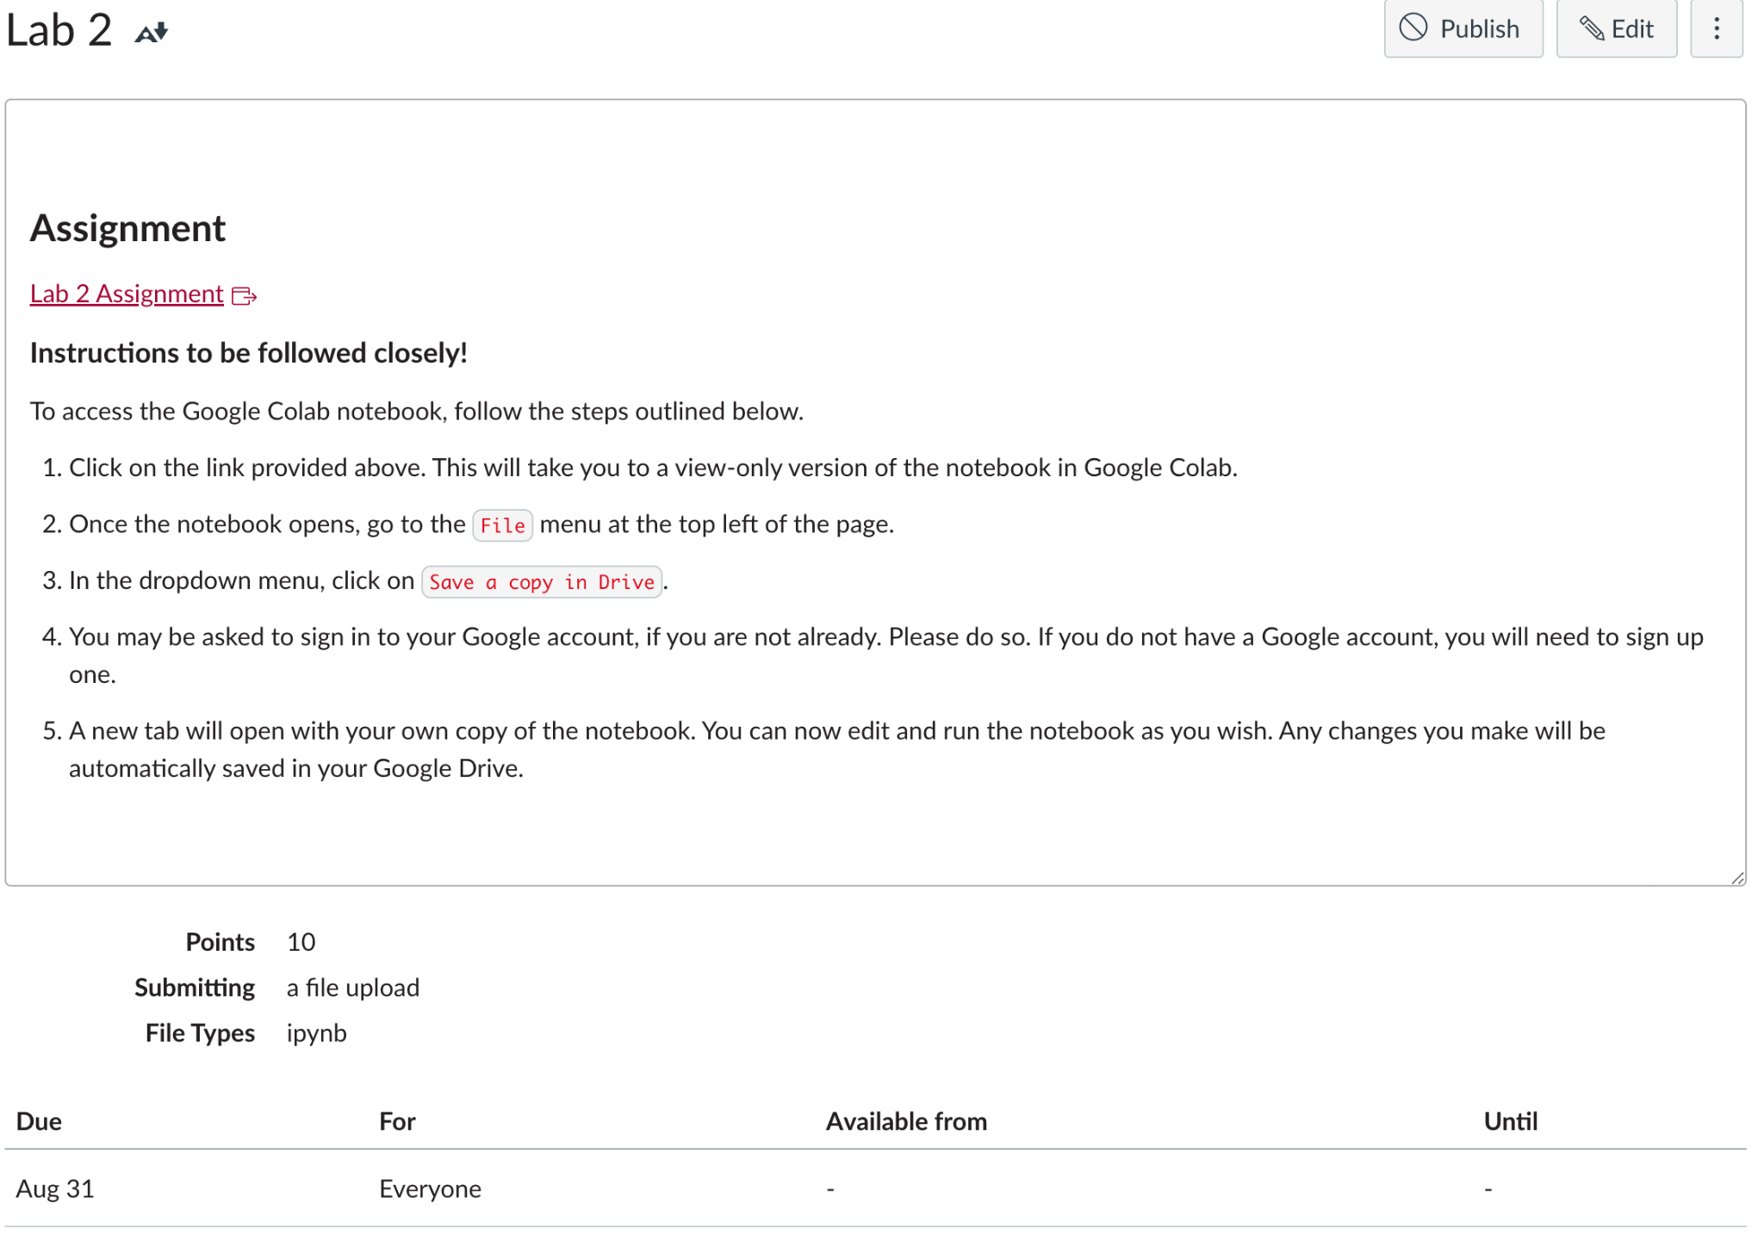
Lab Class 2

